Slide 1
Direct vs. Indirect SLAM: Analysis of LSD-SLAM and ORB-SLAM

Slide 2
Introduction to SLAM
SLAM (Simultaneous Localization and Mapping) builds a map while tracking location.
Steps: Feature extraction, pose estimation, and map update.
Importance: Core for autonomous navigation and mapping.

Slide 3
SLAM Formulations Overview
Two formulations:
Direct SLAM – uses image intensities directly.
Indirect SLAM – relies on extracted features.
Both estimate camera motion and reconstruct the environment.

Slide 4
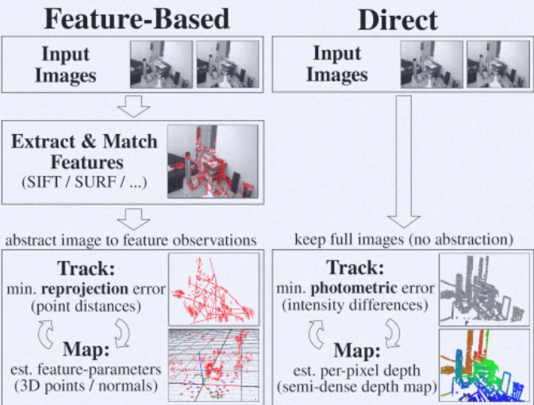

Slide 5
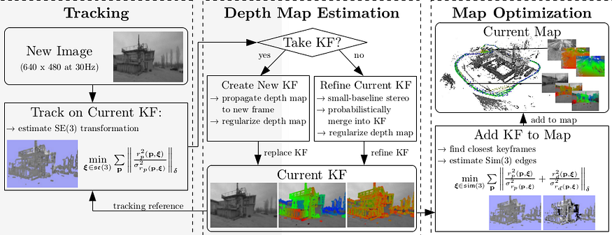
LSD SLAM

Slide 6
Direct vs. Indirect SLAM
Aspect | Direct SLAM | Indirect SLAM
Basis | Uses raw image intensities directly | Uses features (keypoints, descriptors) extracted from images
Computation | Minimizes photometric error (intensity difference) | Minimizes reprojection error (feature position difference)
Feature dependence | Does not require feature detection | Requires robust feature extraction
Suitable for | Texture-rich continuous surfaces (e.g., walls, indoor scenes) | Environments with distinct keypoints (corners, textures)
Example systems | LSD-SLAM, DSO | ORB-SLAM, PTAM
Summary:
Direct methods: better accuracy with dense maps, but computationally heavier.
Indirect methods: robust, efficient, works well with lower-quality cameras.

Slide 7
LSD-SLAM (Large-Scale Direct Monocular SLAM) Overview
Formulation: Direct (uses image intensities instead of extracted features).
Key principle: Minimizes photometric error between keyframes.
Mapping: Semi-dense map representation (only textured pixels).
Advantages:
Works well in low-feature environments.
Generates dense depth maps for better surface understanding.
Limitations:
Sensitive to lighting variations.
High computational cost.

Slide 8
ORB-SLAM (Oriented FAST and Rotated BRIEF SLAM)
Formulation: Indirect (feature-based).
Key principle: Detects and tracks ORB features for matching and map generation.
Mapping: Sparse map representation.
Advantages:
Real-time performance, robust against lighting/scale changes.
Works with monocular, stereo, and RGB-D inputs.
Strong loop closure detection using bag-of-words.
Limitations:
Relies heavily on distinct features (may fail in texture less areas).
Map less detailed compared to LSD-SLAM.

Slide 9
Comparative Analysis
Parameter | LSD-SLAM (Direct) | ORB-SLAM (Indirect)
Data used | Pixel intensities | Feature descriptors
Map type | Semi-dense | Sparse
Robustness to lighting | Low | High
Computational demand | High | Moderate
Loop closure | Moderate | Strong
Accuracy | High in textured scenes | High in structured environments
Real-time performance | Limited | Real-time capable
Inference:
LSD-SLAM excels in dense reconstruction and photometric accuracy.
ORB-SLAM excels in efficiency, robustness, and real-time operation.

Slide 10
Applications
LSD-SLAM: Suitable for autonomous drones, AR systems, and indoor robots needing detailed depth understanding.
ORB-SLAM: Ideal for mobile robots and AR/VR systems where fast, reliable localization is critical.
Key Insights:
LSD-SLAM excels in accuracy
ORB-SLAM excels in robustness and speed.

Slide 11
Summary
Direct SLAM (LSD-SLAM) → Dense, accurate mapping.
Indirect SLAM (ORB-SLAM) → Fast, robust localization.

Slide 12
References
Engel et al., LSD-SLAM: ECCV 2014.
Mur-Artal et al., ORB-SLAM: IEEE Trans. Robotics 2015.
Durrant-Whyte & Bailey, IEEE Robotics & Automation Magazine.
https://medium.com/@j.zijlmans/lsd-slam-vs-orb-slam2-a-literature-based-comparison-20732df431d

